Slide 1
LESSON 8.1
Thermochemical Equations

Slide 2
LESSON GOALS
I can interpret observable changes in physical properties and temperature during changes of state
I can understand the temperature change (decrease or increase) that accompanies endothermic and exothermic reactions
I can sketch and interpret energy profiles for endothermic and exothermic reactions

Slide 3
TASK 1: DEFINITIONS (SHOULD DO)
Define any unfamiliar terms for your notes:
Heat
Temperature
Open system
Isolated system
Closed system
Calorie

Slide 4
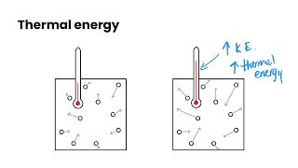
TASK 2: LEARN (MUST DO)
Individually or with a partner:
Watch the Heating Curve of Water video
Take notes for yourself!

Slide 5
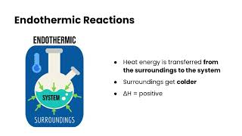
TASK 3: LEARN (MUST DO)
Watch the thermochemical equations video
Complete the appropriate section of the guided note

Slide 6
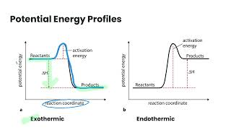
TASK 4: LEARN (MUST DO)
Watch the potential energy profiles video
Complete the appropriate section of the guided note

Slide 7
TASK 5: PRACTICE (MUST DO)
Complete the thermochemical equations practice
Check your answers when you are finished!

Slide 8
TASK 6: MASTERY CHECK (MUST DO)
Complete the thermochemical equations mastery check (see me when you are ready!)

